Slide 1
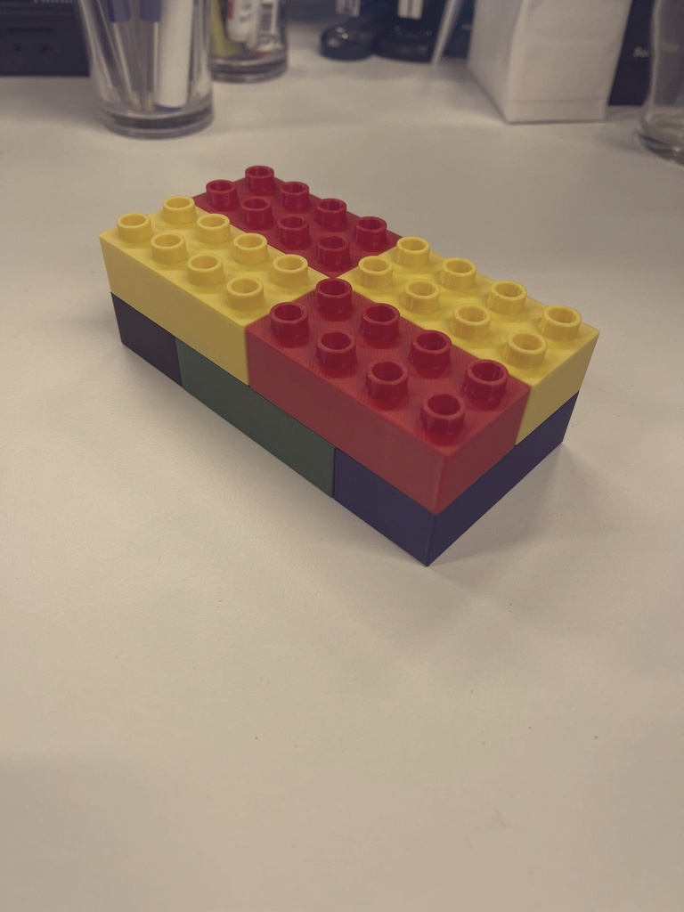
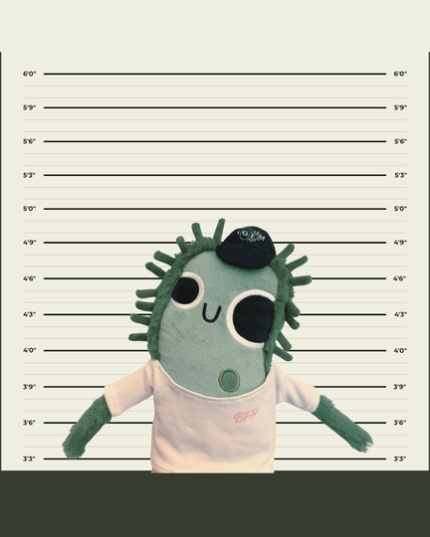
ISSUE #487
I. Gemard
International Press
15.05.2026
STOLEN BRICK STILL MISSING
INTERNATIONAL MANHUNT INTENSIFIES AS GEMY REMAINS IN CUSTODY
PARIS, FRANCE — MONTHS AFTER THE AUDACIOUS THEFT OF THE FIVE REGIONAL IGEM BRICKS FROM THE IGEM HEADQUARTERS, THE STOLEN ITEM REMAINS MISSING DESPITE THE ESTABLISHMENT OF THE INTERNATIONAL BRICK BUREAU AND THE ARREST OF SUSPECT GEMY.
Brick Bureau Launches Global Search While Criminal Organizations Circle
The investigation has revealed a troubling reality: multiple criminal organizations, state actors, and private collectors are actively searching for the brick. Intelligence agencies across Europe, Asia, and North America report increased chatter on dark web marketplaces and encrypted channels, with competitors offering substantial sums for information or possession of the material.
"The brick has effectively disappeared," stated IBB Director Laurent Dupont during a tense briefing. "We have no confirmed sightings, no credible leads on its current location, and mounting evidence that multiple parties are pursuing it with significant resources."
Gemy, the iGEM mascot arrested in connection with the theft, remains in custody in Paris. The suspect has offered limited cooperation with authorities, insisting they acted alone
The Stakes Continue to Rise
As days pass without recovery, security officials grow increasingly concerned about the possibilities: the brick could be sold to the highest bidder, hidden in a private collection, exploited for unauthorized research, or moved across international borders beyond law enforcement's reach.
"Somewhere in the world, someone knows where this brick is," stated Agent Rémi. "We are asking that person to come forward. The principles of open science depend on it."
while providing no information about the brick's whereabouts. We are confident Gemy possesses critical information," Agent Than said. "But extracting that information has proven... challenging."
Page 1

Slide 2
May 15, 2026
CONFIDENTIAL BRIEFING
Subject: Retrival of item stolen from during the 2025 theft at the iGEM secure facility
iGEM teams, the Brick Bureau requests your immediate attention. You are hereby being recruited as Heist Operatives.
THE MISSION
We have reliable intel that the stolen Community Brick will be at the BFH event. In fact, the staff itself have it in their possession. Your first objective is to take it from them.
The brick is successfully taken if no staff observes and calls you out.
Once the Brick is in play, your team must protect it while attempting to steal it from others. At any moment, another team may try to take it from you.
STEALING RULES
Teams are allowed to steal the Community Brick from other teams.
The Brick must always remain visible.
No physical contact such as shoving, grabbing or retaining.
No violence and no hiding, disassembling or purposefully damaging the Brick.
A brick counts as successfully stolen if a team manages to hold onto it for 30 seconds after taking it from another team. During this it is allowed to hide WITH the brick, simply run or create distractions.
DEFENDING THE BRICK
Teams are allowed to:
Protect the Brick together, create elaborate strategies or create distractions outside of presentations and talks.
Form temporary alliances.
Only one team will end the event as: THE HEIST HEROES
They are the last team in possession of the Community Brick on Sunday at 12:30.

